Slide 1
Play

Slide 2
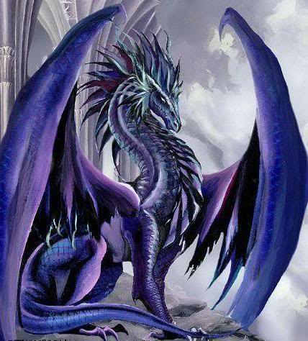
…

Slide 3
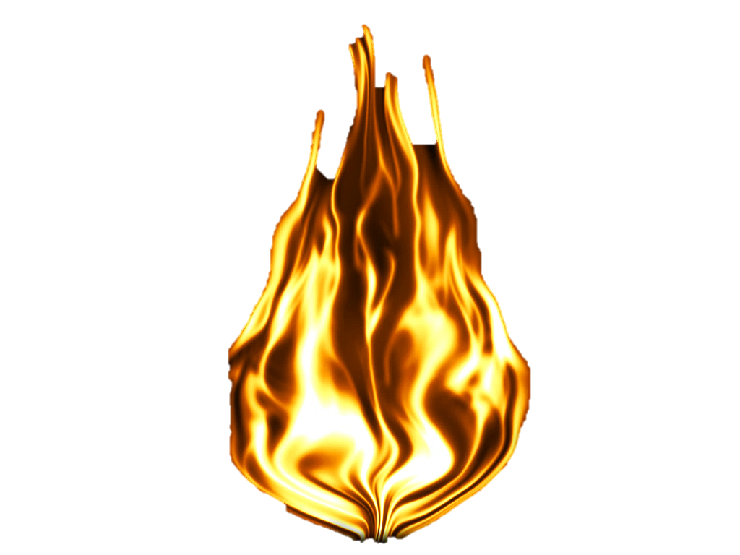

Slide 4


Slide 6
86.6x61.6
Each Player will take a turn to roll the dice. after the player reaches its new position it will take out a mystery card. after that it'll be the next players turn. the first player to reach the end will have the chance to fight the Dungeon Boss
Each player will take a turn to roll the dice. After the player reaches its new position it will be the next player's turn. The first player to reach the end will have a chance to fight the Dungeon Boss

